Slide 1
ECONOMIC EVALUATION IN HEALTH · FACULTY WORKSHOP · SESSION 4
Costing your own service
Micro and gross costing, bottom up and top down, capital and shared overheads, and where Indian unit costs already exist. Then you cost one episode of care yourselves.
Drummond et al., 4th ed., Chapter 7, and the Indian Reference Case, principle 5
Notes:
Twenty minutes of slides, thirty minutes on the worksheet, five minutes of report-back. Hold the slides to twenty minutes even if the room wants to argue; the worksheet is where the learning happens. Worksheets should already be on the tables, one per group.

Slide 2
By the end of this session
Tell a price from a cost, and say why it matters
Choose between micro and gross costing, bottom up and top down
Annuitise a piece of equipment and allocate a shared overhead
Say where Indian unit costs already exist before collecting your own
Cost one episode of care in your department, roughly
Notes:
Objective 5 is the one that matters. Everything else is in service of the worksheet.

Slide 3
Prices are not costs
In 2018, many PM-JAY package prices bore little relation to what the care cost to deliver.
Share of packages priced below half their measured cost | Share
2018, before revision | ~42%
2019, after costing evidence was used to revise them | ~20%
In the revision, 61% of package prices went up and 18% came down. The evidence was hospital costing across public tertiary hospitals.
A price is what someone pays. A cost is what the care uses up.
Prinja, Singh, Rajsekar et al., Applied Health Economics and Health Policy, 2021.
Notes:
The hook. Costing is not an accountant's hobby; it moved national reimbursement rates. Ask who in the room has ever been told what a procedure "costs" and later found that figure was a charge, a tender price or a package rate. All three are prices.

Slide 4
Three steps, every time
Identify
Measure
Value
Which resources does the care use? Staff, drugs, consumables, tests, equipment, space, the share of the hospital that keeps the lights on.
How much of each, per episode? Minutes, units, days, uses.
What is each unit worth? Salary per minute, purchase price, annuitised capital, allocated overhead.
Most errors happen at identify: something is simply never counted.
Notes:
Session 3 named these three steps while framing the question. Here we practise them on a service in this room, which is where they stop being abstract. The commonest omissions: capital, shared overheads, and the time of staff who are "already paid for".

Slide 5
"But the nurse is already paid for"
An economic cost is the value of what the resource could otherwise have done.
Resource | Financial cost to the budget | Economic cost
Staff time on the new service | zero extra, if salaried | the minutes, at salary per minute
Donated equipment | zero | its market value, annuitised
A room that already exists | zero | its share of the building
Economic evaluation uses economic cost, because the question is what else those minutes could have done.
Notes:
This is opportunity cost from Session 2 arriving at ward level. The nurse spending 45 minutes on the new procedure is not spending them somewhere else. That is the cost.

Slide 6
Two choices about method
Bottom up: count what each patient uses
Top down: divide a total by the output
Micro
costing:
every item
Most precise. Minutes timed, items counted, priced one by one. Slow; can miss shared costs.
Department totals split finely by activity. Captures overheads; needs good accounts.
Gross
costing:
big blocks
A few large components per patient: a bed-day, an operation, a course of drugs.
Fastest. Annual budget ÷ patients. Every patient looks average.
Precision where the money is; gross costing for the rest.
Notes:
Two separate questions: how finely do you cut (micro versus gross), and which direction do you come from (bottom up versus top down). People conflate them. Most real studies mix all four cells, micro-costing the expensive, variable items and gross-costing the small ones.

Slide 7
Bottom up and top down, side by side
Bottom up
Top down
Follow patients. Time the staff, count the items, price each.
Start from the department's annual spend. Divide by patients, or bed-days.
Sees variation between patients.
Misses anything nobody thought to count: supervision, idle time, overheads.
Sees every rupee the department spends.
Misses that a complex case uses more than a simple one.
India's national hospital costing uses both.
The Cost of Health Services in India study planned a mixed top-down and bottom-up method across 52 public and 40 private hospitals in 13 states.
Prinja, Singh, Guinness, Rajsekar, Bhargava, BMJ Open, 2020.
Notes:
Bottom-up totals are usually lower than top-down totals for the same service, because bottom-up misses things. If a paper uses only bottom-up costing and reports a very low cost, ask what was left out.

Slide 8

Staff time: usually the biggest line
Available minutes: working days × productive hours × 60. Leave, teaching and admin are not available.
Constructed example | Value
Staff nurse, monthly gross | ₹60,000
22 days × 6 productive hours × 60 | 7,920 min
Cost per minute; 45 minutes on the episode | ₹7.58; ₹341
Constructed figures to show the arithmetic, not a real pay scale. The same row is on your worksheet.
Notes:
Using all contracted hours rather than productive hours understates the cost per minute. The denominator is where people go wrong, not the numerator.

Slide 9
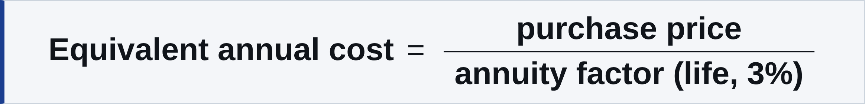
Capital: annuitise, never the purchase price
Constructed example: an ultrasound machine | Value
Price ₹5,00,000; life 10 years; factor at 3% | 8.530
Equivalent annual cost | ₹58,617
÷ 2,000 scans a year | ₹29 a scan
Charging ₹5,00,000 to one year makes that year's patients look absurdly expensive, and every later year's look free.
Constructed figures. Factor table on the worksheet. 3% is the Reference Case discount rate.
Notes:
The annuity factor is the present value of one rupee a year for n years at 3%. Nobody needs the derivation today; they need to know that the table exists and that capital belongs in the cost.

Slide 10
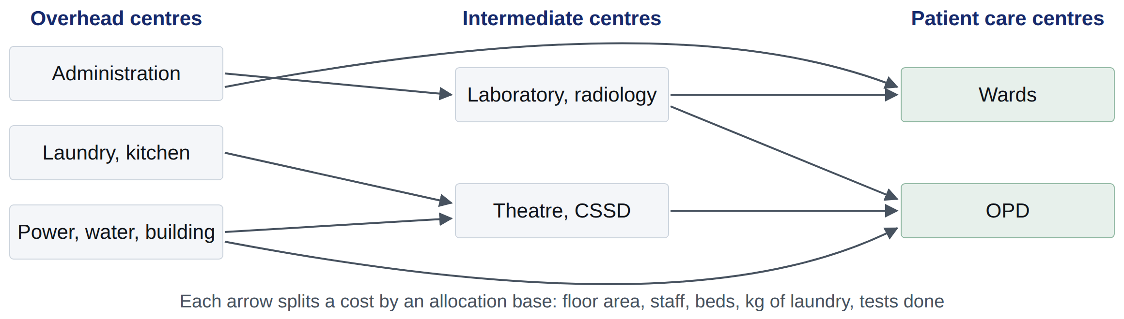
Shared overheads: the costs nobody owns
Step down: every cost ends up at a centre that sees patients.
Notes:
This is how the national hospital costing study allocates support and indirect service centres to patient care centres, using apportioning statistics. Keep it at this level. The point is that a ward's cost per bed-day includes a slice of the laundry and the administration, and a study that leaves them out is too cheap.

Slide 11
One allocation, worked
Constructed example: laundry | Value
Hospital laundry, annual cost | ₹12,00,000
Your ward's share, by kg of linen | 15%
Allocated to your ward | ₹1,80,000
÷ 3,000 patient-days a year | ₹60 a patient-day
Repeat for each shared service, or, if you cannot, use a stated mark-up and say where it came from.
Constructed figures to show the arithmetic.
Notes:
For the worksheet they will not know their hospital's laundry budget. That is fine: they should write down the allocation base they would use and a guess, and mark it as the number they are least sure of. That is question (b) on page 2.

Slide 12
Average cost is not the cost of one more
Adding ten scans a day to a machine that is idle half the time costs the consumables and the staff minutes. Not another machine.
Average cost
Marginal cost
Total cost ÷ output. Right for pricing a service and for a programme at full scale.
The extra cost of one more unit. Right for a small change at the edge of existing capacity.
Ask which one a paper used, and whether it fits the decision it is informing.
Notes:
The reverse error matters too: a scale-up that needs a second machine has a marginal cost far above the average. Capacity constraints decide which is relevant.

Slide 13
Before you collect: Indian unit costs already exist
You need | Go to
Unit costs of public services, primary to tertiary | National Health System Cost Database
Hospital procedure costs, public and private | Cost of Health Services in India study
What a curative package is reimbursed at | PM-JAY package rates: a price, not a cost
Out-of-pocket spending by condition | National Sample Survey
None of these fits | Primary costing, following the HTAIn methods guidance
healtheconomics.pgisph.in/costing_web/ · Prinja et al., PharmacoEconomics Open, 2020; BMJ Open, 2020.
Notes:
If the connection allows, open the database for thirty seconds. Then point out that the Reference Case treats PM-JAY as the payer for curative care, so package rates are legitimately used as the cost to the payer in many HTAIn studies. That is a perspective choice, not an error, as long as it is labelled.

Slide 14
Five costing errors to catch in a paper
Charges or prices used as costs, without saying so
Capital left out, or charged in full to one year
Overheads left out. Bottom-up alone, with no allocation
Average cost used for a marginal decision, or the reverse
Old costs, new decision: cost year and currency not stated, or not updated
Every one of them makes the intervention look cheaper, or hides that it is not.
Notes:
These are the costing row of the appraisal checklist, principle 5, turned into things to look for. Tell the groups to check their paper for all five at lunch.

Slide 15
Your turn: the worksheet
5 min
20 min
5 min
Choose one episode your department delivers. Define where it starts and ends. Map the pathway.
Fill in staff, items, equipment and overheads. Rough numbers. Mark the ones you are guessing.
Add up. Compare with a PM-JAY rate if one exists. Answer the three questions on page 2.
The goal is not the right number. It is knowing which number you do not know.
Notes:
Same groups as the paper exercise, which are formed by specialty cluster. Each group picks one member's department and costs an episode there. Walk round. The two most useful interventions: "what did you leave out?" and "which line would you measure properly first?" Take three groups' totals and their answer to question (b) in the last five minutes.

Slide 16
And your paper
Where did its costs come from: a database, a trial, package rates, the literature?
Bottom up, top down, or not stated?
Whose costs: the hospital's, the payer's, the patient's?
Which of the five errors can you find?
Write it in row 5 of the checklist before lunch.
Notes:
A two-minute reminder at the end so the paper groups keep moving. They do this after the worksheet, or over lunch.

Slide 17
Sources
Drummond MF, Sculpher MJ, Claxton K, Stoddart GL, Torrance GW. Methods for the Economic Evaluation of Health Care Programmes. 4th ed. Oxford University Press; 2015. Chapter 7, Cost analysis.
Sharma D, Prinja S, Aggarwal AK, Rajsekar K, Bahuguna P. Development of the Indian Reference Case for undertaking economic evaluation for health technology assessment. Lancet Reg Health Southeast Asia 2023;16:100241. PMID 37694178
Prinja S, Singh MP, Rajsekar K, Sachin O, Gedam P, Nagar A, Bhargava B; CHSI Study Group. Translating research to policy: setting provider payment rates for strategic purchasing under India's national publicly financed health insurance scheme. Appl Health Econ Health Policy 2021;19(3):353–70. PMID 33462775
Prinja S, Singh MP, Guinness L, Rajsekar K, Bhargava B. Establishing reference costs for the health benefit packages under universal health coverage in India: cost of health services in India (CHSI) protocol. BMJ Open 2020;10(7):e035170. PMID 32690737
Prinja S, Chauhan AS, Bahuguna P, et al. Cost of delivering secondary healthcare through the public sector in India. PharmacoEcon Open 2020;4(2):249–61. PMID 31468323
National Health System Cost Database for India. PGIMER Chandigarh and Department of Health Research. healtheconomics.pgisph.in/costing_web/
Notes:
Not for reading out. Worked examples on the staff, capital and laundry slides are constructed.

