Slide 1
ECONOMIC EVALUATION IN HEALTH · FACULTY WORKSHOP · SESSION 5
Outcomes, discounting
and the ICER
Drummond et al., Methods for the Economic Evaluation of Health Care Programmes, 4th ed., 2015.
Chapter 4, pages 77 to 123.
Faculty, residents and research project staff · AIIMS Bhopal, 23 September 2026
Notes:
Sessions 3 and 4 built the numerator, in principle and then on their own ward. This session builds the denominator, discounts both, and then does the only arithmetic in the day they will be asked to reproduce by hand.

Slide 2
By the end of this session
Explain what a QALY is, and where its weights come from
Say why a QALY is not a DALY, and why that matters for a league table
Justify discounting and apply India's 3%
Tell an average ratio from an incremental one
Rank several options and find simple and extended dominance
Compute an ICER, or use net monetary benefit instead
Notes:
Objective 5 separates understanding incremental analysis from having memorised the formula. Every paper in the room depends on it.

Slide 3
6 Measuring health outcomes
Measure | Captures | Comparable across
Deaths averted, cases detected, mmHg lowered | one dimension only | the same outcome only
Life-years gained | length of life | anything affecting survival
QALYs and DALYs | length and quality | any health programme
Cost per case detected cannot be set against cost per stroke prevented, so you cannot allocate a budget.
India's recommendation: use QALYs.
Notes:
Put the problem before the solution. Ask how they would choose between a cataract programme and a hypertension programme using cost per case detected. They cannot, and that discomfort is what the QALY was invented to relieve.

Slide 4
The QALY, in one sentence
A year of life in full health is worth 1. A year in a worse state is worth less. Add them up.
The weight, the utility, runs from 1 for full health to 0 for a state as good as being dead, and can go below zero for states judged worse than death.
Two years at a utility of 0.5 count the same as one year at 1.0.
That equivalence is the QALY's power and its controversy. It is what lets you compare a cancer programme with a mental health programme. It also makes people uneasy, because the arithmetic treats those two years and that one year as interchangeable.
Notes:
Say the controversy out loud rather than hiding it. A room told the QALY is unproblematic stops thinking. A room told exactly where it is contested engages with it properly.

Slide 5
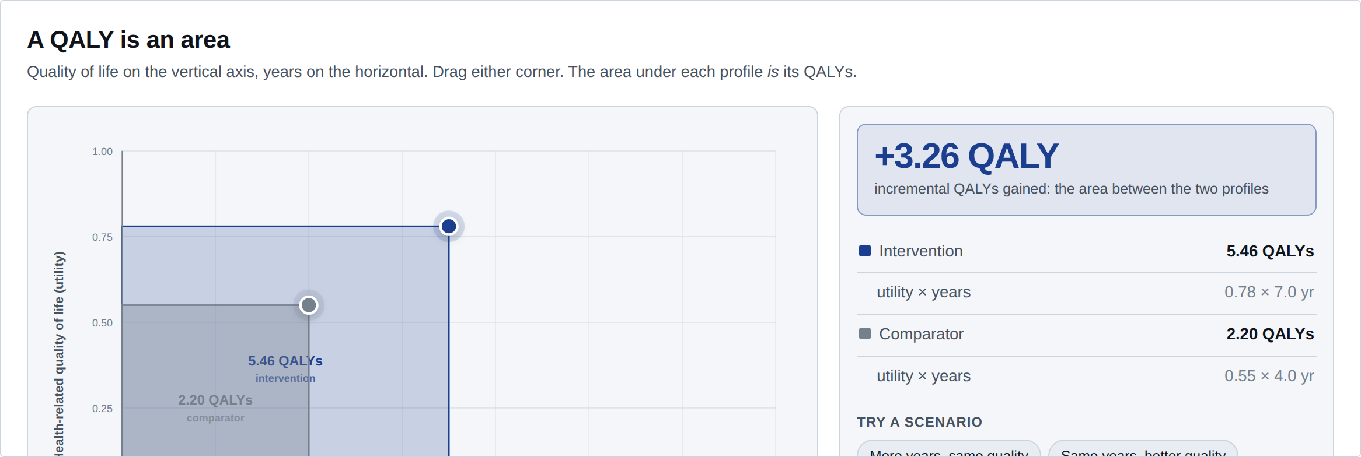

A QALY is an area. Build one
Quality up, years across; the area is the QALYs. Produce the same gain three ways: more years, better quality, or fewer but much better years.
All three are identical to the QALY, which is its central limitation · sph-aiimsbhopal.github.io/intro-economic-evaluation-health
Notes:
Four minutes. Then run the three presets in order: more years at the same quality, the same years at better quality, fewer years at much better quality. All three produce roughly the same QALY gain. Ask whether a patient would regard them as the same. They would not. That is the limitation, stated by the measure itself.

Slide 6
Where do the utility weights come from?
Time trade-off
Standard gamble
EQ-5D
How many of your 10 years in this state would you give up to be in full health for the rest?
What risk of immediate death would you accept for a certain cure?
Describe your health on five dimensions and five levels. A national value set converts that to a number.
The values come from the general public, not from patients.
Deliberately so. The public bear the opportunity cost and fund the system. Patients who have adapted to a condition rate it higher than the public do, which would systematically reduce the apparent value of treating it.
Notes:
The public versus patient question is a live debate, not a settled matter. Present it as contested. It is the kind of nuance that makes a referee report worth reading.

Slide 7
India has its own value set. Use it
The DEVINE study produced an EQ-5D-5L value set for India, so utilities no longer have to be borrowed.
Applying a UK tariff to Indian patients is now an avoidable flaw.
Age group | What the Reference Case asks for
Adults | EQ-5D-5L with the Indian value set
8 to 15 years | EQ-5D-Y, five-level
4 to 15 years, valuation | the Indian adult value set, until a paediatric one exists
Under 4 years | DALYs permitted, using GBD disability weights
Jyani, Sharma, Prinja, Kar et al., Value in Health, 2022.
Notes:
Note the honesty in the Reference Case. It says outright that using adult values for children is a compromise, gives the reason it is the lesser of two evils, and asks for a paediatric value set to be developed. That is what good methodological guidance looks like: it names its own weak points.

Slide 8
QALYs are not DALYs
QALY, gained
DALY, averted
Health produced. Preference-based weights from 0 to 1, usually from the general public. You maximise it.
Health lost. Disability weights plus years of life lost against a reference life expectancy. You minimise it.
"ICER per DALY averted is not directly equivalent to ICER per QALY gained."
Session 6 puts up an Indian league table that mixes 70% DALY studies with 30% QALY studies. Remember this slide when you see it: that is why the table cannot be read straight down the column.
Notes:
Second time you have raised this: Session 2 warned about it, here is the mechanism, and Session 6 shows what it does to a published ranking. That repetition is deliberate. It is the most durable confusion in this subject for community medicine trainees.

Slide 9
8 Discounting
A rupee next year is worth less than a rupee today. So, the argument goes, is a QALY. Discounting converts future costs and health into present values, so programmes with different timing can be compared at all.
3%
India, costs and outcomes, beyond one year
0% to 5%
the range to test in sensitivity analysis
undiscounted
report these too, for every scenario
3% is chosen partly so Indian results can be compared with everyone else's.
Notes:
Emphasise that discounting health, not just money, is the contested part. Discounting money is uncontroversial, because money can be invested. Discounting health needs a separate argument, and not everyone accepts it.

Slide 10
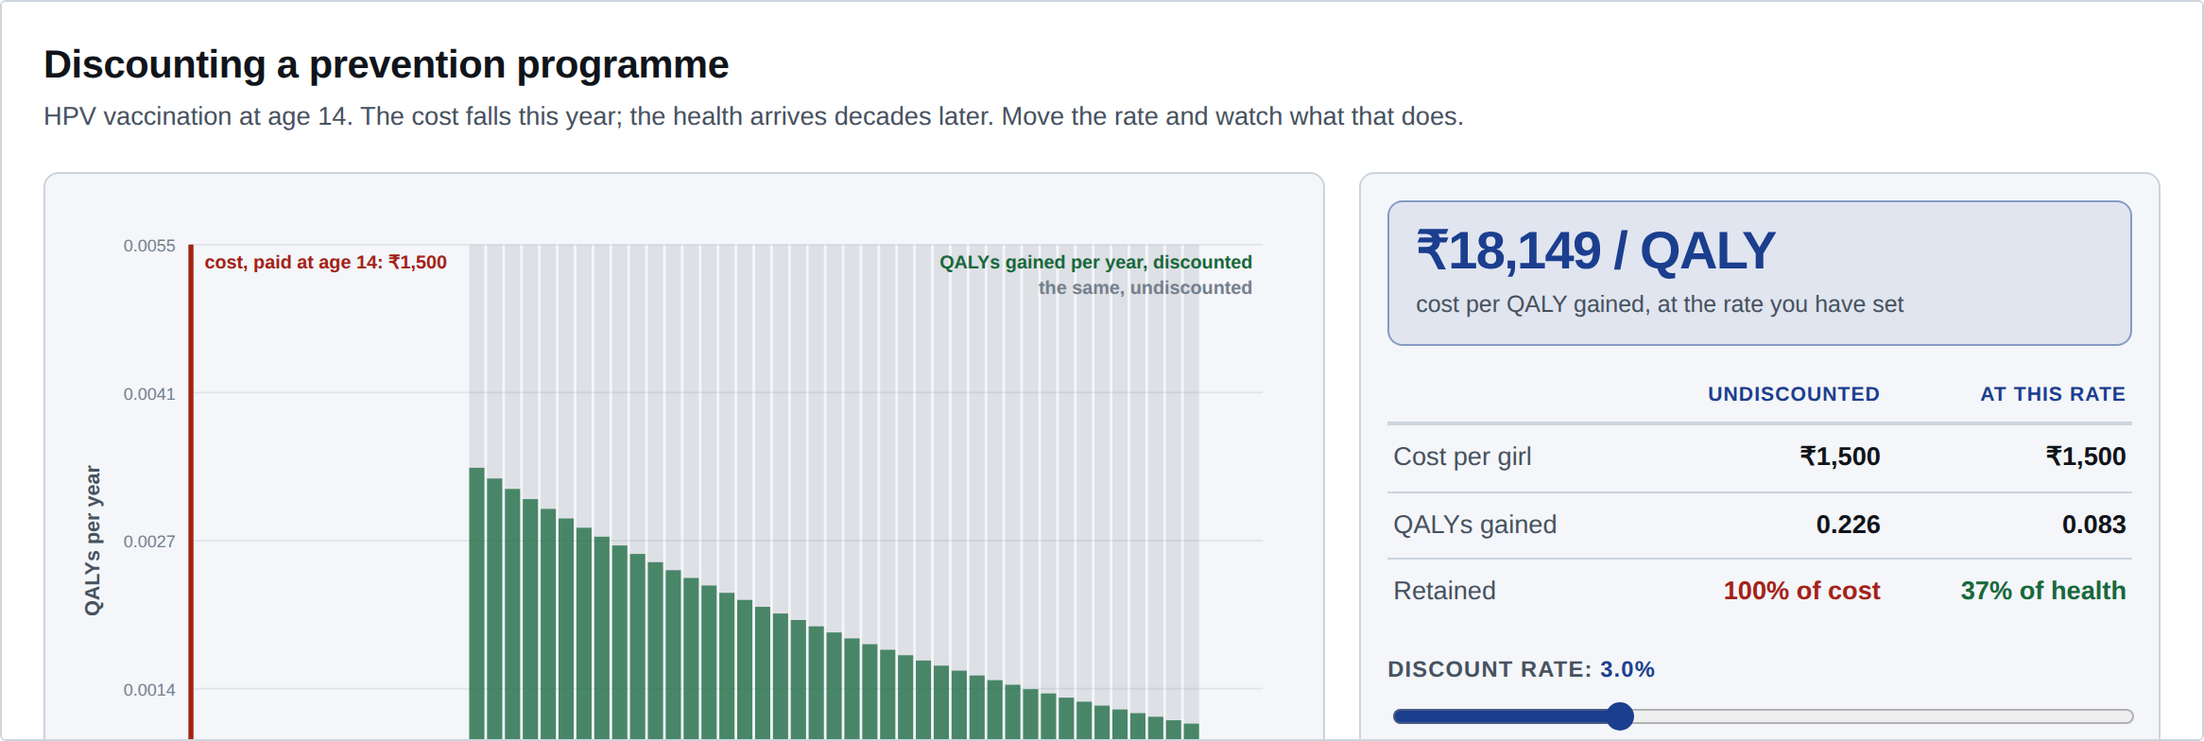

What a discount rate does to prevention
A cost paid at 14, health arriving from 30. Move the rate 0% to 5% and read the two "retained" figures: the cost barely moves, the health falls away.
Which is why prevention looks worse at any given rate · sph-aiimsbhopal.github.io/intro-economic-evaluation-health
Notes:
Have them move the rate from 0% to 5%. The cost keeps 100% of its value because it is paid today. The health keeps a fraction, because it arrives decades later. Then ask: is that a fact about the world, or a choice we made? It is a choice, which is the next slide.

Slide 11
Why discounting health is contested
The objection
The reply
Discounting health at the same rate as money disadvantages prevention, and therefore the young, whose benefits arrive furthest in the future. Some argue health should be discounted less, or not at all.
If health is discounted less than money, then delaying any programme by a year makes it look better, and you could generate unlimited apparent gain by never starting. That is absurd, so the rates should match.
Neither side has won. State your rate, test it, and report undiscounted results too.
Notes:
The delay paradox is an elegant argument and the room usually enjoys it. It is due to Keeler and Cretin. You need not attribute it on the slide, but say it if asked.

Slide 12

The ICER, written out
1 is the new option, 0 the comparator. C and E are discounted totals per person.
Unit of E | What the ICER is then called | Read as
QALYs gained | Cost–utility ratio | ₹ per QALY gained
DALYs averted | Cost per DALY averted | ₹ per DALY averted
Cases detected, deaths averted | Cost-effectiveness ratio | ₹ per case, ₹ per death averted
Same formula. Only the denominator changes.
Notes:
Write it on the board as well. Two things to stress. Both terms are differences, so an ICER always belongs to a pair of options and never to one option alone. And the denominator decides what the number means, which is why a cost per QALY and a cost per DALY cannot be compared even though both are rupees over a health unit.

Slide 13
Three ways it goes wrong
Divide by totals
ΔE near zero
Sign blindness
Using C1 ÷ E1 instead of the differences. Gives an absurdly small number, as on the next slide.
The ratio explodes, or is undefined at exactly zero. The two options may still differ in cost, which matters.
ΔC ÷ ΔE is the same number whether both are positive or both negative, and those are opposite decisions.
A negative ICER is uninterpretable on its own. You have to go back and look at the signs of ΔC and ΔE separately.
Net monetary benefit fixes all three. We get to it shortly.
Notes:
Plant the flag here and collect it at the NMB slide. These are not exotic failures, they are what the ratio form of the question does to ordinary arithmetic, and all three turn up in print.

Slide 14
Average is not incremental
Screening with VIA every five years, over a lifetime, discounted at 3%:
 | Cost per woman | QALYs | Ratio
Average ratio | ₹4,600 | 22.530 | ₹204 per QALY
Incremental ratio, vs no screening | ₹3,400 | 0.130 | ₹26,154 per QALY
₹204 per QALY is not a bargain. It is a meaningless number.
The average ratio divides the programme's cost by her entire remaining lifetime of quality-adjusted life, almost all of which she would have had anyway. Only the incremental ratio asks what we get for the extra money.
Illustrative figures, constructed for teaching.
Notes:
A ratio near ₹200 per QALY should trigger disbelief. Teach that instinct: if an ICER looks impossibly good, check whether someone divided by total rather than incremental QALYs.

Slide 15
Ranking five options
Per woman, lifetime, 3% discounting. Ranked by cost, where you always start.
Strategy | Cost | QALYs | ΔCost | ΔQALYs | ICER
No screening | ₹1,200 | 22.400 | – | – | –
VIA every 10 years | ₹3,400 | 22.440 | ₹2,200 | 0.040 | ₹55,000
VIA every 5 years | ₹4,600 | 22.530 | ₹1,200 | 0.090 | ₹13,333
Cytology every 5 years | ₹6,800 | 22.515 | ₹2,200 | −0.015 | –
HPV DNA every 5 years | ₹9,100 | 22.560 | ₹2,300 | 0.045 | ₹51,111
Two of these should never be chosen at any threshold. Which two?
Illustrative figures, constructed for teaching.
Notes:
Ninety seconds in pairs before revealing. Most rooms find the cytology row quickly: it costs more and delivers fewer QALYs than VIA every five years. Almost nobody finds the other one unaided, which is what makes the next two slides land.

Slide 16
Simple dominance
Cytology every 5 years costs ₹6,800 for 22.515 QALYs. VIA every 5 years costs ₹4,600 for 22.530.
More expensive and less effective. Strike it out. No threshold can rescue it.
This is the north-west quadrant of the cost-effectiveness plane, met again in a table. Once an option is dominated, remove it and recompute the ICERs below it, because the comparisons have changed.
Its ICER is not "very large". It is negative and meaningless, which is why the column shows a dash.
Notes:
The cost-effectiveness plane widget is four slides ahead; say that they will see this quadrant interactively then. Here it is as a row in a table, which is how it appears in a real paper.

Slide 17
Extended dominance, the subtle one
Read the ICER column downwards: ₹55,000 for VIA every 10 years, then ₹13,333 for VIA every 5 years.
The ICER falls as you move down. That cannot be right.
VIA every 10 years is extendedly dominated: at any threshold where you would accept it, you would already have accepted the better-value option below it.
After removing both dominated options | Cost | QALYs | ICER
No screening | ₹1,200 | 22.400 | –
VIA every 5 years | ₹4,600 | 22.530 | ₹26,154
HPV DNA every 5 years | ₹9,100 | 22.560 | ₹1,50,000
Now the ICERs rise as cost rises.
Notes:
The diagnostic rule is worth writing on the board. Rank by cost, remove simple dominance, then look for a falling ICER. A falling ICER always means extended dominance. Recompute after each removal.

Slide 18
So what do we fund?
Strategy | ICER vs the option below | At λ ≈ ₹2,12,307, for now
VIA every 5 years | ₹26,154 | accept
HPV DNA every 5 years | ₹1,50,000 | accept, and the last that qualifies
Climb the frontier one step at a time, for as long as each step costs less than λ per QALY.
Borrow λ for now: ₹2 lakh per QALY, near a published Indian estimate. At ₹80,000 instead you would stop at VIA every five years. The question is not "which is best" but "how far up can we afford to go", and where that λ comes from is Session 6.
Illustrative figures. Threshold from Chugh et al., Value in Health, 2026.
Notes:
Be explicit that λ is on loan here. Ranking needs a number, so we use one and interrogate it after the break. Change λ and the answer changes while the analysis does not: make them say which strategy wins at ₹80,000 before you show it. That is the hook into Session 6.

Slide 19
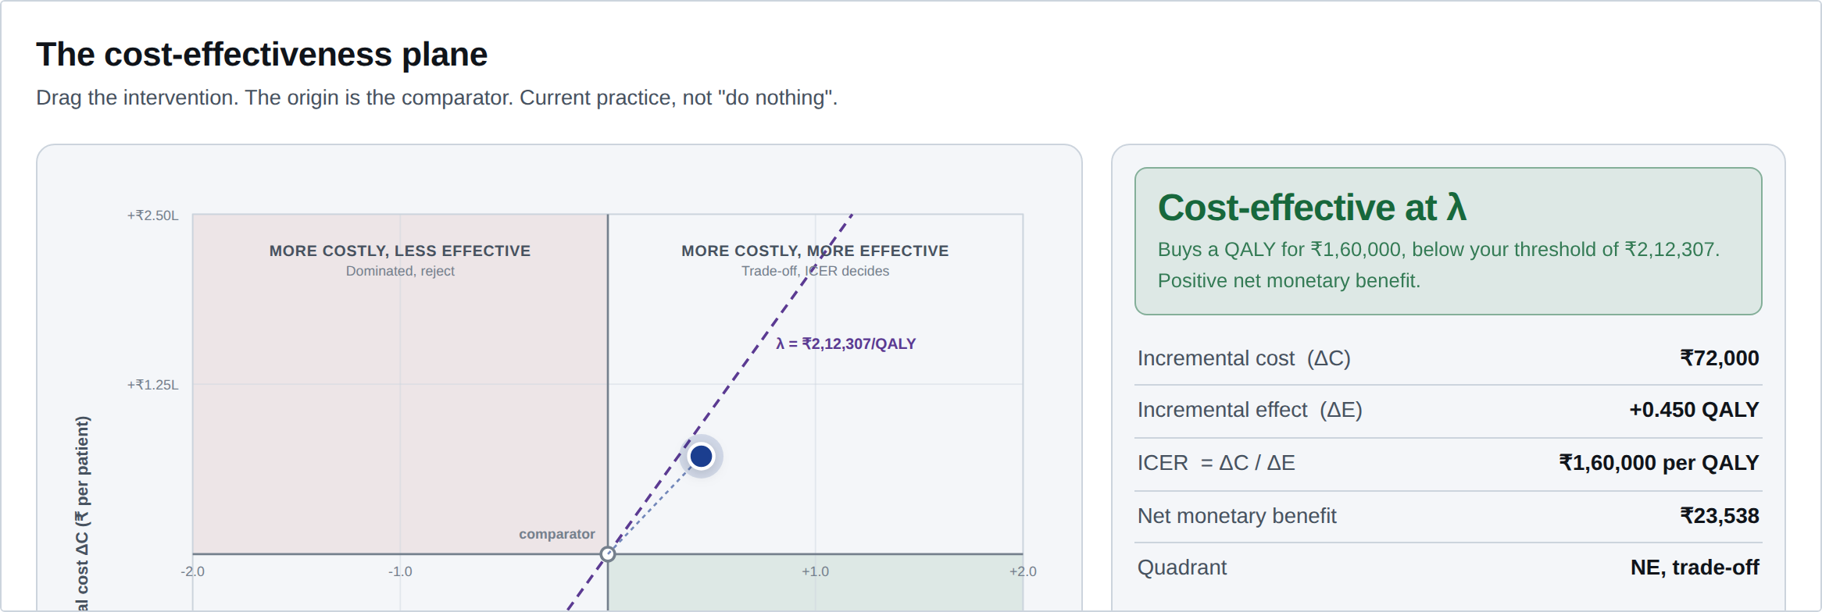

The same logic, on the plane
The ranking you just did, drawn. The frontier is the set of points you would climb, and a dominant option sits below and to the right of another. Drag λ and the verdict changes.
On your phone: sph-aiimsbhopal.github.io/intro-economic-evaluation-health
Notes:
First time they meet the plane interactively. Give them two minutes on their phones: move the threshold line and watch points cross it. Then point at the net monetary benefit row, which the next slide explains.

Slide 20
Net monetary benefit, the cleaner form
Value the health gained at the threshold, then subtract what it cost. Both terms in rupees.
Positive means adopt. That is the whole rule.
No division, so nothing explodes when ΔE is small, and the sign carries the meaning that an ICER loses.
VIA every 5 years, from the table: ΔE = 0.090 QALYs, ΔC = ₹1,200, at India's λ of ₹2,12,307.
Notes:
Collect the flag planted at "three ways it goes wrong". Walk the three failures across: no denominator, so no explosion; signs preserved, so dominant and dominated separate cleanly.

Slide 21
The same decision, three ways
Form | Formula | Adopt when
ICER | ΔC ÷ ΔE | ICER < λ, and ΔE > 0
Net monetary benefit | (λ × ΔE) − ΔC | NMB > 0
Net health benefit | ΔE − (ΔC ÷ λ) | NHB > 0
NHB is NMB divided by λ, so it says the same thing in QALYs instead of rupees: the health you buy, minus the health displaced elsewhere to pay for it.
All three agree, but only the ICER needs a side condition.
Notes:
Do the arithmetic live for one row of the ranking table. VIA every five years: 0.090 QALYs for ₹1,200 at a threshold of ₹2,12,307 gives an NMB of about ₹18,000, and an NHB of about 0.084 QALYs. Same decision, three currencies. Then note that the side condition on the ICER row is exactly what gets forgotten, and it is what makes a dominated option look acceptable.

Slide 22
Why NMB, and not the ratio
 | ICER | Net monetary benefit
When ΔE = 0 | undefined | fine, it is just −ΔC
Dominated vs dominant | both negative, indistinguishable | opposite signs
North-east vs south-west | same value, opposite meaning | opposite signs
Averaging across simulations | incoherent | straightforward
Which is why probabilistic analysis is counted on NMB, not on the ratio.
Notes:
NMB is under-taught and removes most of the confusion around ICERs. Give it its own minute. The price is that you must commit to a value of λ up front, which people find uncomfortable. That discomfort is revealing, since using an ICER only hides the same commitment.

Slide 23
The same arithmetic, on a drug
One year of adjuvant trastuzumab against chemotherapy alone. Same model, same costs, same country. Only the source of the effectiveness estimate differs.
Effectiveness estimate from | QALYs gained | ICER per QALY gained
The HERA trial | 1.29 | ₹1,78,877
Joint NSABP B-31 and NCCTG N9831 analysis | 1.69 | ₹1,34,413
Nothing in the numerator moved. A bigger denominator made the ICER a third smaller.
Which is why the incremental ratio is a claim about two numbers, not one. Session 8 returns to this table and puts a probability on each row.
Gupta, Verma, Gupta, Prinja, JCO Global Oncology, 2020.
Notes:
Work the arithmetic on the board if there is one: the incremental cost is the same in both rows, so the whole gap is the denominator. ₹1,78,877 against ₹1,34,413 is a third, produced entirely by which trial you believe. Then send them to their own paper: what is its ICER, and what one number would you have to disbelieve to change it?

Slide 24
Recap
A QALY is quality times time: an area, not a score. India has its own value set
Utilities come from the general public, and that is deliberate
QALYs and DALYs cannot share a league table
Discount both at 3%, test 0 to 5%, report undiscounted too
Average ratios are meaningless. Only incremental ones answer a decision
Rank by cost, remove dominance, then look for a falling ICER
Notes:
If you are short of time, the two lines that must survive are "average ratios are meaningless" and the falling-ICER rule for extended dominance.

Slide 25
Sources
Drummond MF, Sculpher MJ, Claxton K, Stoddart GL, Torrance GW. Methods for the Economic Evaluation of Health Care Programmes. 4th ed. Oxford University Press; 2015. Chapter 4, pp. 77–123.
Sharma D, Prinja S, Aggarwal AK, Rajsekar K, Bahuguna P. Development of the Indian Reference Case for undertaking economic evaluation for health technology assessment. Lancet Reg Health Southeast Asia 2023;16:100241. PMID 37694178
Jyani G, Sharma A, Prinja S, Kar SS, et al. Development of an EQ-5D value set for India using an extended design (DEVINE) study. Value Health 2022;25(7):1218–26. PMID 35779943
Chugh Y, Jyani G, Kar SS, Rajsekar K, Prinja S, et al. Estimating the willingness-to-pay per quality-adjusted life-year to aid health technology assessment in India. Value Health 2026;29(3):457–66. PMID 41176029
Chauhan AS, Prinja S, Srinivasan R, et al. Cost effectiveness of strategies for cervical cancer prevention in India. PLoS One 2020;15(9):e0238291. PMID 32870941
The five-strategy ranking table is constructed for teaching, built so that simple dominance, extended dominance and a frontier all appear at once. No single published Indian paper shows all three cleanly.
Notes:
Note the last entry. Be explicit about which numbers are real and which are teaching constructions. It models the honesty the day is asking of them.

Slide 26
FACULTY WORKSHOP · SESSION 6 · DRUMMOND 4TH ED., CHAPTER 2
Where does
λ come from?
You have just ranked five strategies against a threshold you were handed. The next session asks who set it, by which of two incompatible methods, and what follows when the two disagree.
Also: opportunity cost, league tables, and budget impact, the question a finance department asks that an ICER does not answer.
Notes:
This is the pivot of the day. Everything so far has been machinery; the next session is judgement. Ask them, before the slide, what ₹2,12,307 might be a measurement of. Most will guess a budget figure, which it is not.

